Slide 1

Final Year Project Presentation on Activity Tracker Using Python
Under The Guidance Of
Mrs. Aparna Shukla
Birla Institute Of Technology, Ranchi

Slide 2
Presented By : Batch 1
Binay Asim Purty - BCA/40579/18
Prince Kumar - BCA/40595/18
Tirthoraj Dasgupta - BCA/40606/18
Shubham Kr. Dutta – BCA/40609/18

Slide 3
Objectives :
Introduction
Technical Requirements
Software Requirements
Hardware Requirements
Essential Modules
HOG Algorithm For Face Recognition
ER Diagram
User Flow Diagram
Working Of Our Software
Advantages
Limitations
Conclusions
Sources

Slide 4
What our project is all about.
Our Project is a Real time Activity Tracker software.
The aim of the project is to track the activity of the user.
It monitors whether the user who has logged In , is present in his position.
It also has a Countdown timer for the user which works to show the left working hours.

Slide 5
The software checks for the user availability infront of the monitor , continuously after any random interval of time.
If Presence of the user is recognized, The software notes the time and the countdown timer is carried forward.
If Absence of the user is recognized, The software stops the countdown timer until user is recognized.
It maintains the record, whether the user is present for the allotted hours or not.
We have used Python to build this project.

Slide 6

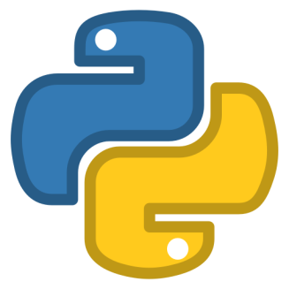
Minumum Technical Requirements Of Our Project
Software Requirements
Visual Studio Code is a freeware source-code editor made by Microsoft for Windows, Linux and macOS.
Python is an interpreted high-level general-purpose programming language.

Slide 7

Hardware Requirements
A PC/Laptop with:
Modern Operating System:
x86 64-bit CPU (Intel / AMD architecture)
4 GB RAM.
5 GB free disk space.
1.6 GHz or faster processor.
A Web Cam enabled
System or an External
Web Camera.

Slide 8



Essential Modules
OS module :
Datetime module :
String module :

Slide 9




OpneCV module :
Face Recognition module :
Tkinter module :
Smtplib Module :

Slide 10



Random Module :
Numpy module :
Shutil module :

Slide 11
HOG Algorithm For Face Recognition
The recognition of a face in a video sequence is split into three primary tasks: Face Detection, Face Prediction, and Face Tracking.
The tasks performed in the Face Capture program are performed during face recognition as well. To recognize the face obtained, a vector of HOG features of the face is extracted.
This vector is then used in the SVM model to determine a matching score for the input vector with each of the labels. The SVM returns the label with the maximum score, which represents the confidence to the closest match within the trained face data.

Slide 12
The task of calculating matching scores is exceptionally heavy to compute. Hence, once detected and identified, the labeled face in an image needs to be tracked to reduce the computation in future frames until the face eventually disappears from the video.

Slide 13
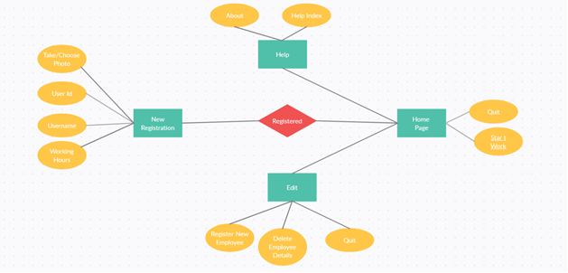
ER Diagram

Slide 14
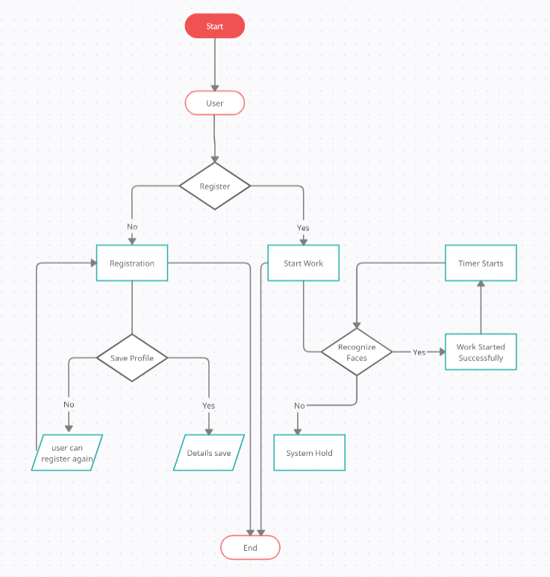
Work Flow Diagram Of proposed System

Slide 15
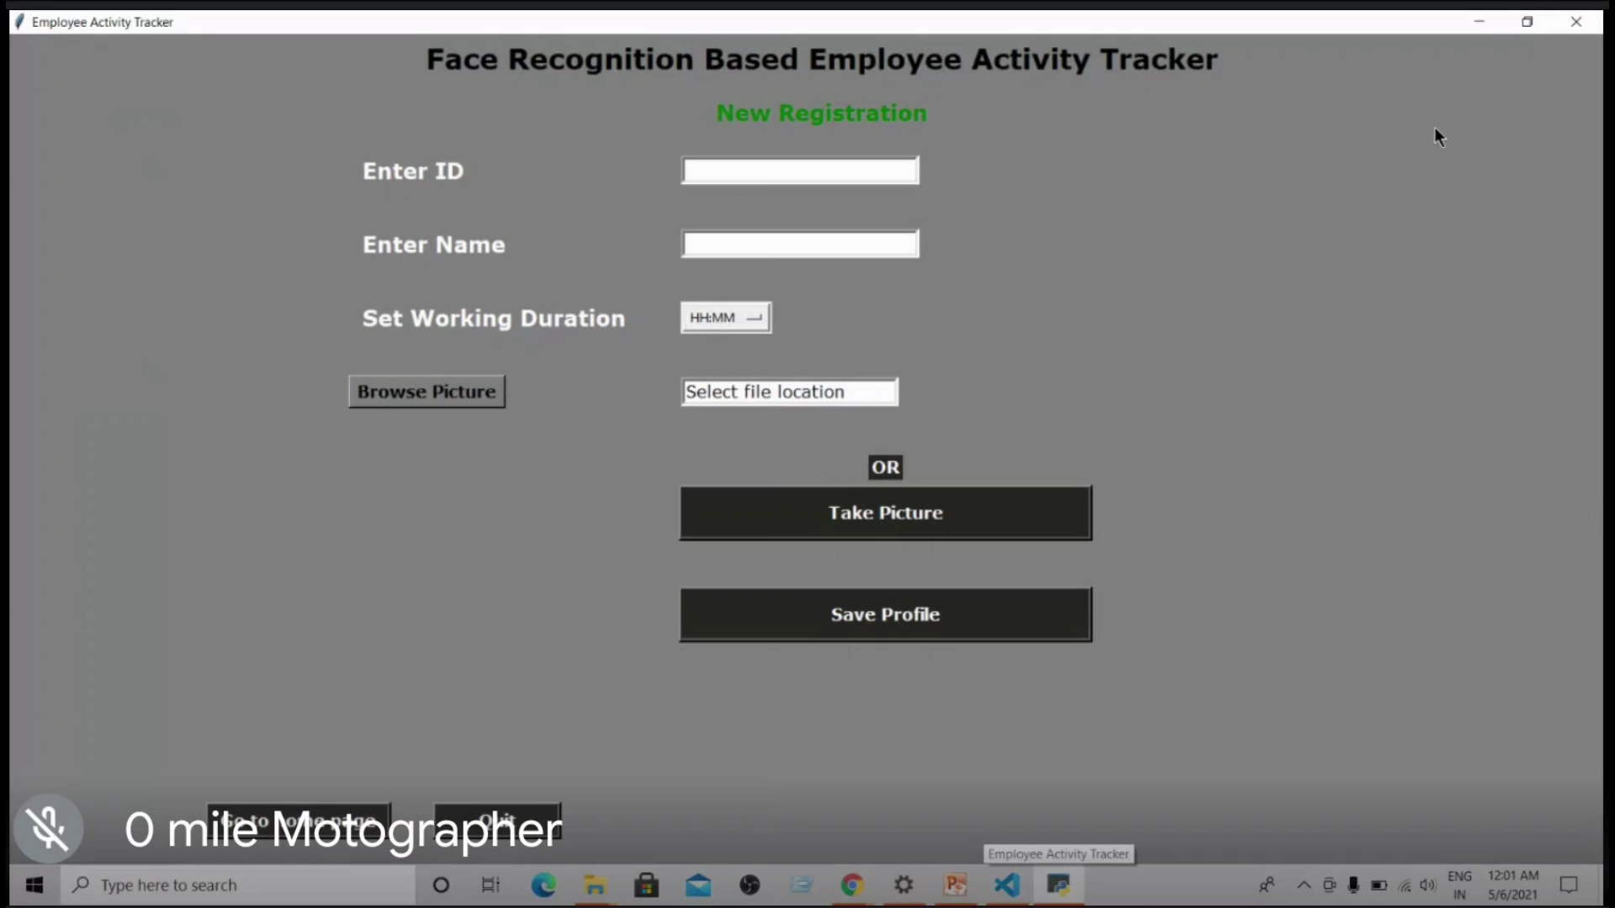
Working Of Proposed System

Slide 16



Advantages
The User cannot trick the organisation .
The work efficiancy is increased.
Potential of an individual is correctly
determined.

Slide 17


Limitations
1
It is restricted to single user
functioning.
During its run , As it uses the camera
the camera may not open for some
Other applications.

Slide 18
Conclusion…
Our project is a Machine Learning based Activity tracker using python programming.
Our project is useful for various Industrial organizations and also educational institutes.
We Learned a lot about Python programming and its use in Machine Learning.
We learned a lot about Python’s various modules, libraries and their uses in making real-life applications.
We learned about how HOG algorithm can be used for detection and recognition.

Slide 19


Sources
Geeks For Geeks
YouTube
https://www.geeksforgeeks.org/
https://www.youtube.com/

Slide 20
Thanks

